Slide 1
Engineering Hearts
Northeastern University Engineering World Health

Slide 2
Did you know...
Can you guess what’s moving in this image?
Heart cells isolated from the body can spontaneously beat on their own.
Your heart can continue beating even when disconnected from your body.
Heart cells stop dividing, so heart cancer is very rare, but heart attacks are very dangerous.
Notes:
https://www.youtube.com/watch?v=PFeAhLJ1vL0
Beating Cardiomyocytes in Cell Culture
What does the heart do?
How can we track the heart’s activity?

Slide 3
Why is it so important to keep the heart pumping?
Your body needs blood! The heart pumps up to 2000 gallons of blood a day throughout your body.
How do we track the heart’s activity and make sure it’s working?
Notes:
https://www.youtube.com/watch?v=PFeAhLJ1vL0
What does the heart do?
How can we track the heart’s activity?

Slide 4
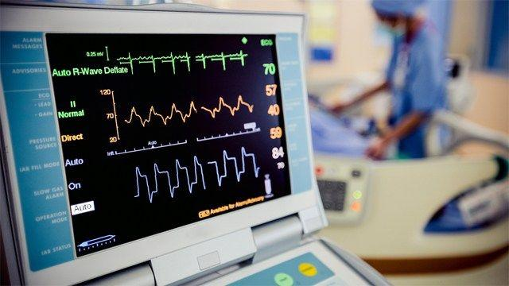
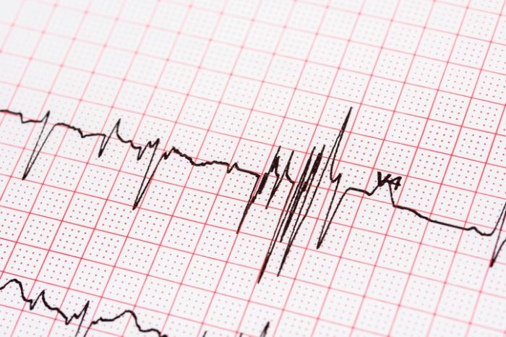
Electrocardiogram (EKG or ECG)
Electrocardiogram (EKG or ECG)
Electrocardiogram (EKG or ECG)
Electrocardiogram (EKG or ECG)
Recording the
electrical activity
of the heart
Notes:
A medical instrument that measures and records (gram) the electrical activity (electro) of the heart (cardio)
Measures heart’s electrophysiological pattern/biopotentials using electrodes to detect electrical changes on the skin
Electrode - electrical conductor used to make contact with nonmetallic part of a circuit (skin)
Can be used to diagnose abnormalities or to monitor vital signs
MAKE INTERACTIVE

Slide 5
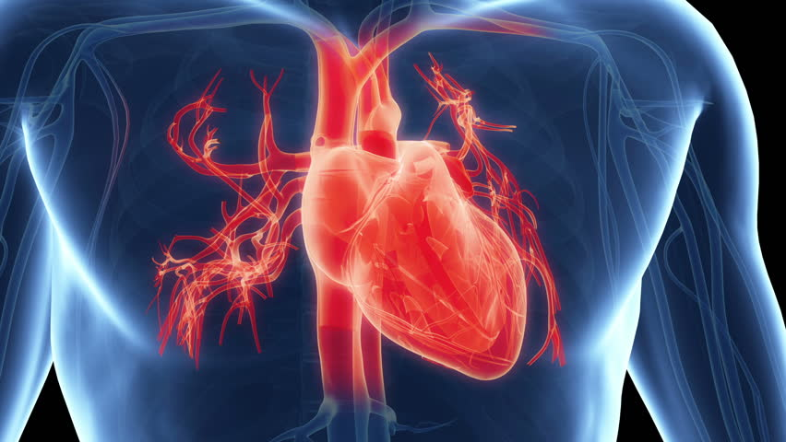
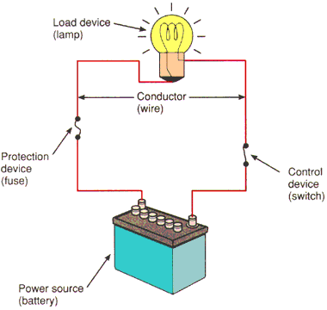
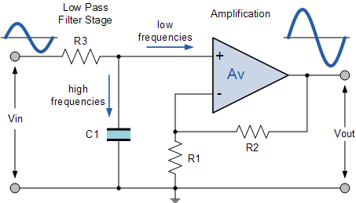
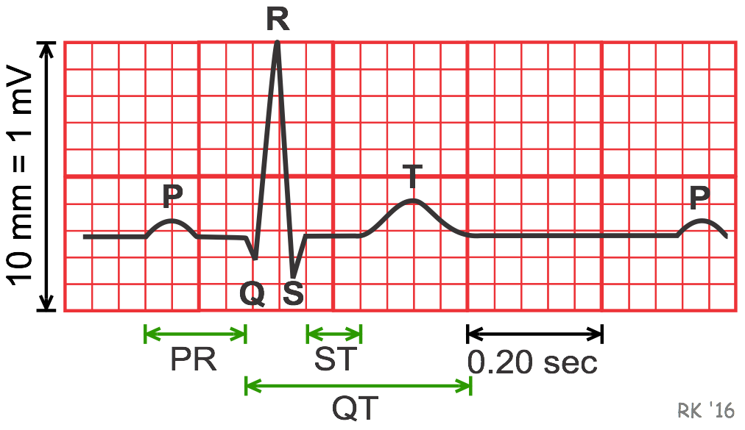
Learning Goals
Basic mechanics and electrical activity of the heart
Circuit basics and how to wire a simple circuit
Filter and amplify electrical signals
Complete EKG circuit and measure
Discuss global health design considerations

Slide 6
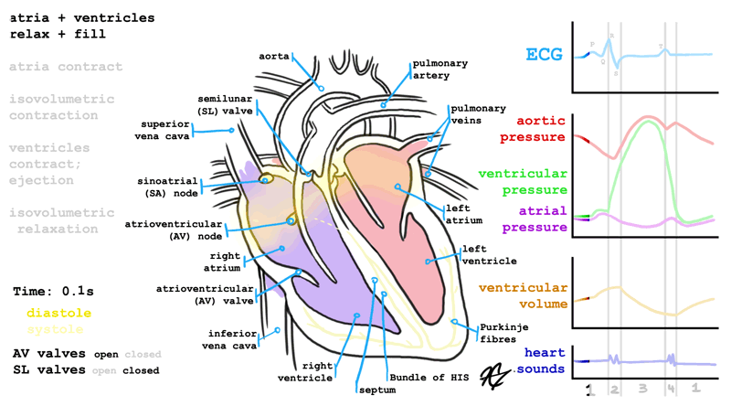
Cardiac Physiology
Notes:
Just a cool gif
150000

Slide 7
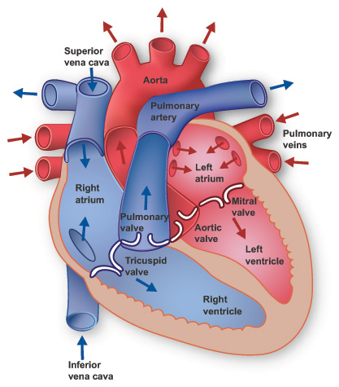
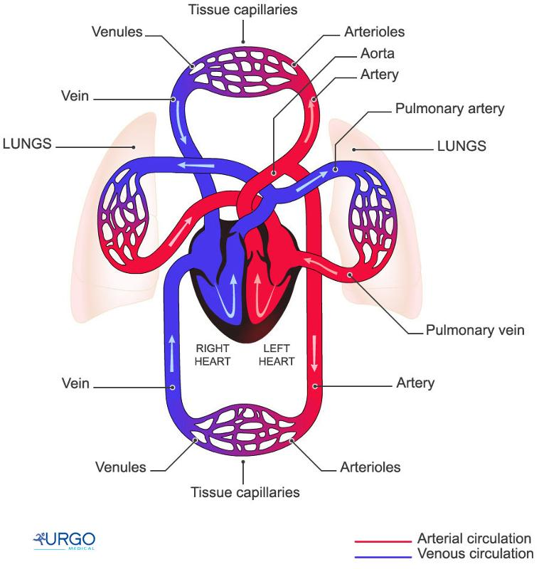
Heart Anatomy
Notes:
Right side - deoxygenated blood
Left side - oxygenated blood
Atria - receive blood (from lungs or body)
Ventricles - pump out blood (to lungs or body)
Arteries - carry blood away from heart
Veins - carry blood to heart
Valves - keep blood from going backwards

Slide 8
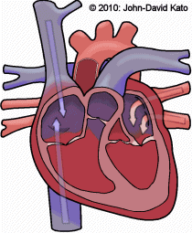
Mechanism of the Heart
Notes:
Systolic (contraction) v diastolic (relaxation) pressures
Maybe a quick way to show this (balloon A video of blood pressure being measured + sound
What are the 2 numbers you usually see when your blood pressure is measured?
Contraction → raise pressure → blood flow (eventually bring back to circuit/water analogy)

Slide 9
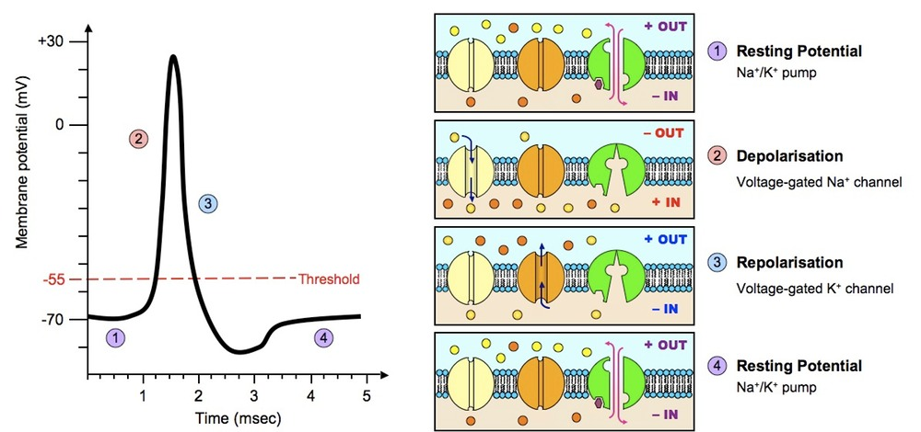
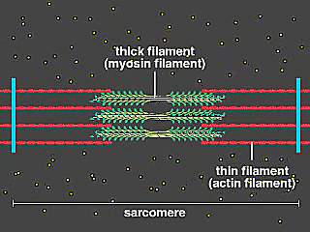
Action Potentials to Action
Action Potential
Muscle Contraction
Notes:
Review action potential
Release of calcium...power stroke and sliding filament

Slide 10
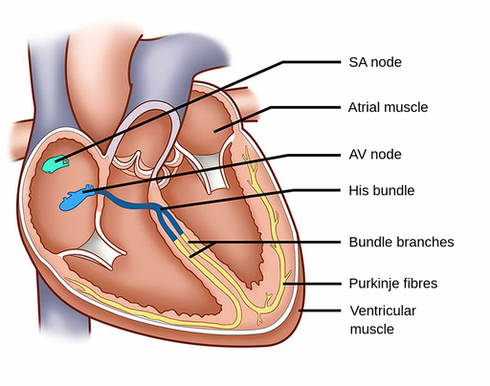
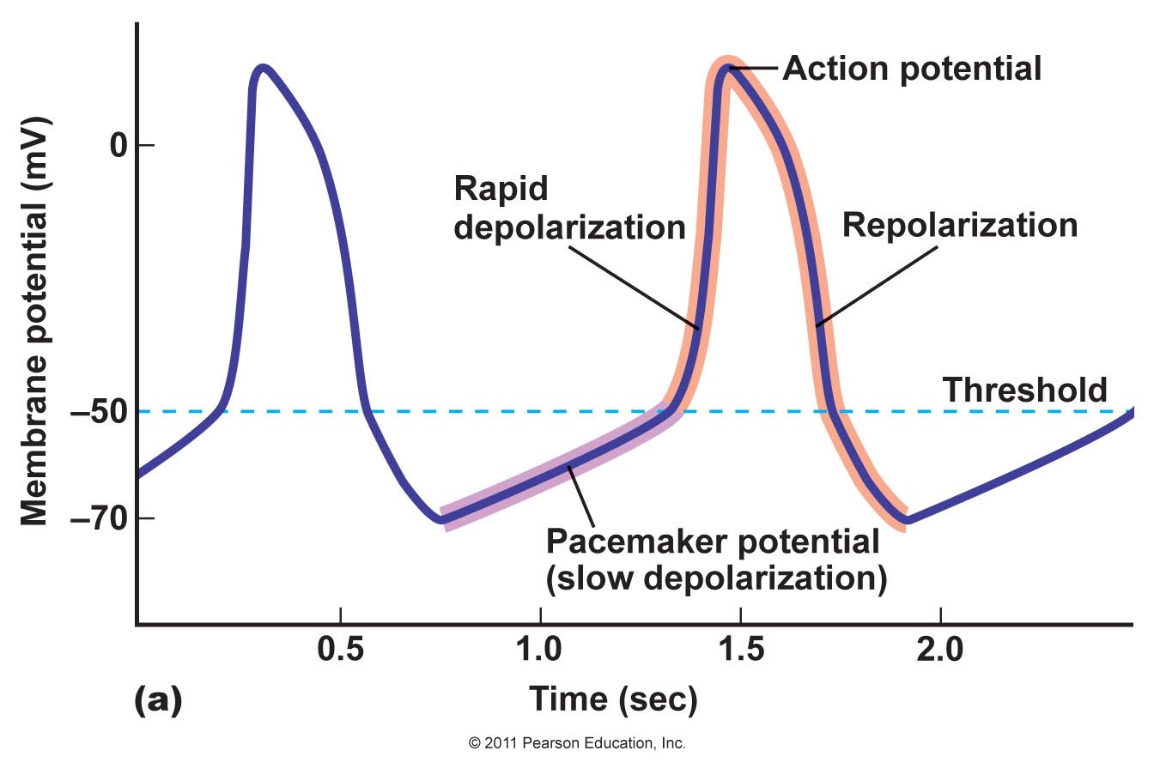
Generation of the Cardiac Action Potential
Notes:
Generation
The sinoatrial node (pacemaker) - generates action potentials without neurons
Funny current - at very low potentials channels open slowly making the cell potential more positive
Once hitting a certain voltage threshold the pacemaker cells rapidly depolarizes making a characteristic action potential

Slide 11
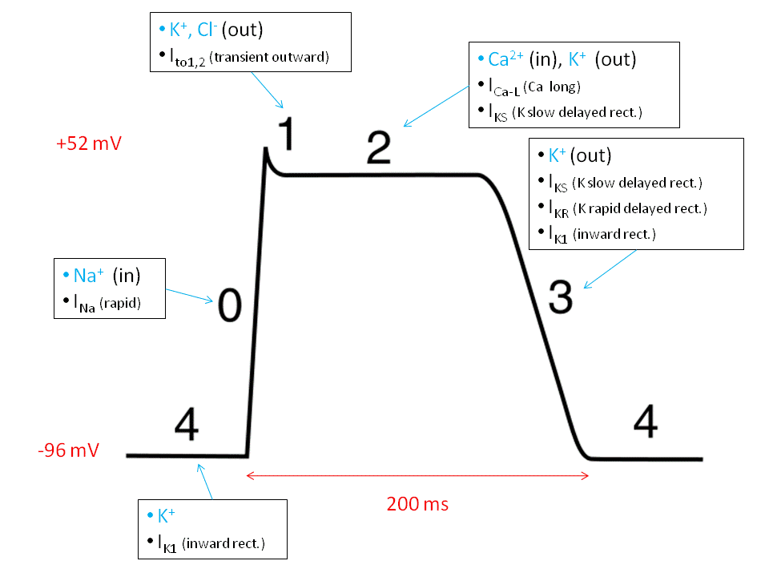
Propagation of the Cardiac Action Potential
Notes:
Propagation
Cells are connected by gap junctions - action potential to flow from pacemaker cell to adjacent myocytes/contractile cells
Incoming action potential, raises potential in myocyte, generating an action potential
The action potentials pass from one myocyte to the other through gap junctions as well
Myocyte Action potential
Na+ enters - Fast depolarization
K+ leaves - small repolarization but Ca++ enters - balances
Ca++ channels close, just K+ is leaving - repolarizes the cell

Slide 12
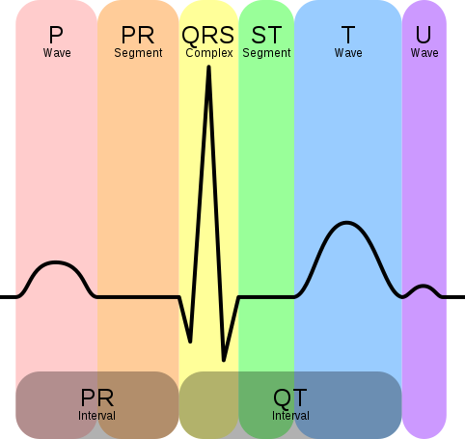
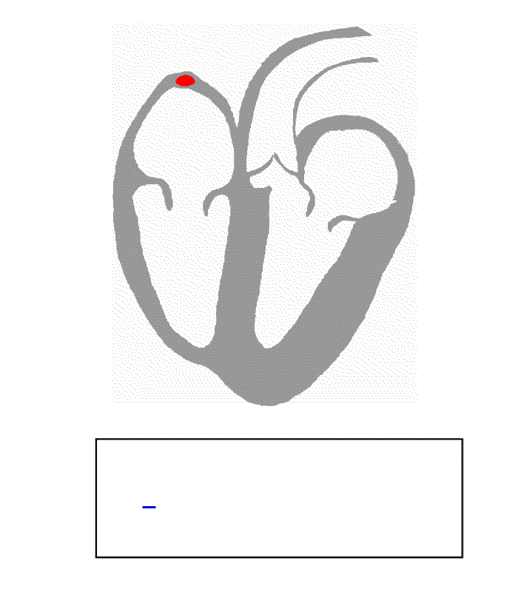
Anatomy of EKG Signal
Notes:
Take out notes

Slide 13
P Wave and PR Interval
P Wave - Atria depolarization and contraction
PR Interval - AV node slows down action potential
Notes:
P wave
Atria depolarization → contract (atrial systole)
Starts at sinoatrial node and spread to both atrial
Lasts less than 80ms
PR Interval
Impulse to travels from the SA node and through the AV node
PR segment - the atrioventricular node slows down the action potential
PR interval = 120-200ms, PR segment = 100ms

Slide 14
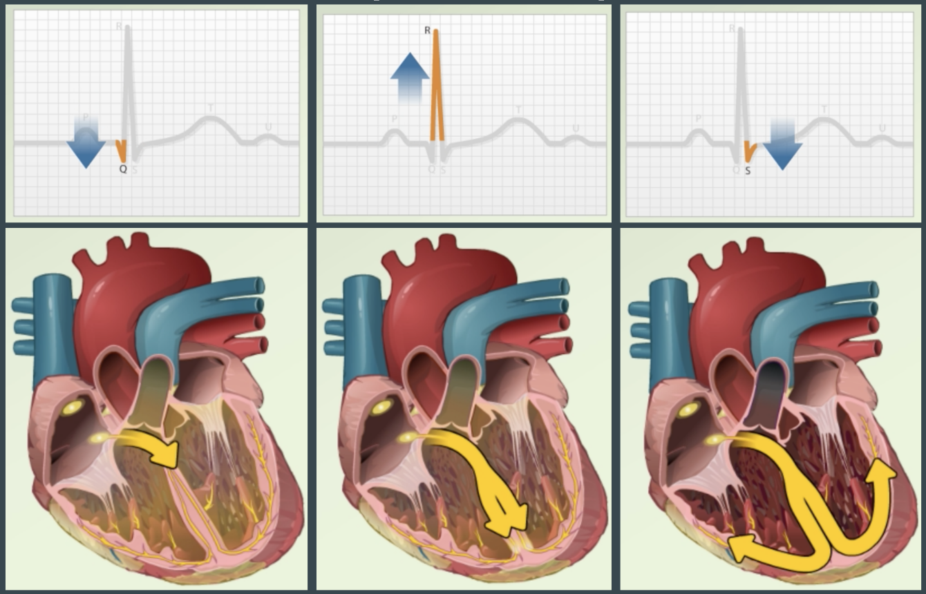
QRS Complex
QRS Complex - Ventricles depolarize and contract
Notes:
Ventricles depolarize, down septum and through walls → contract
The whole complex should last about 80-100ms

Slide 15
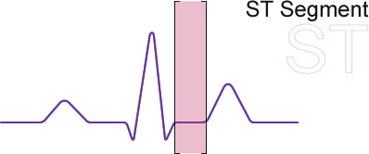
ST Segment and T Wave
ST Segment - Ventricles stay depolarized and contracted
T Wave - Ventricles repolarize and relax
Notes:
ST segment
Ventricles stay depolarized and contracted
Should be isoelectric
Should last for 5-150ms
T wave
Ventricles repolarize and relax, ending ventricular systole
The repolarization should take about 160ms
Takes longer to repolarize than depolarize

Slide 16
Trace Diagnosis Activity

Slide 17
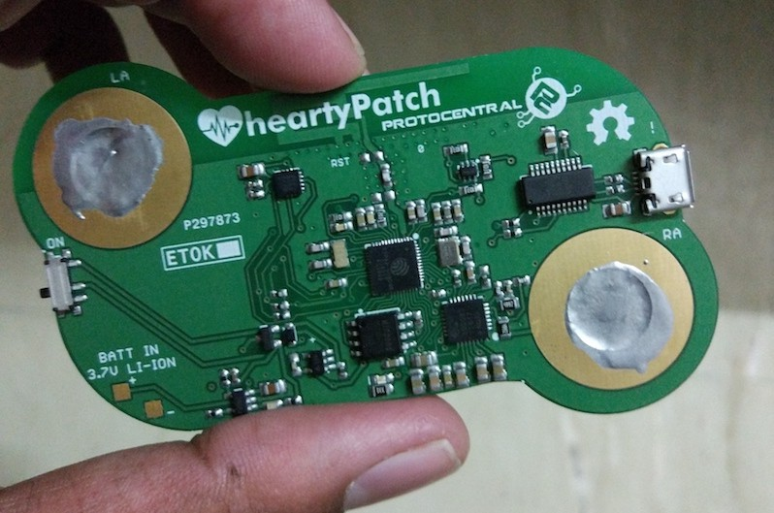
Circuit Basics
Notes:
For current to flow, the circuit must be closed
Circuits have:
A source of electrical potential (battery or power outlet)
A load or device that consumes energy (ex. light bulb)
Conductors (wires) that form a closed path for the electrons

Slide 18
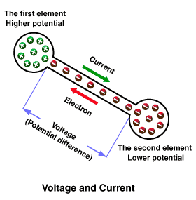
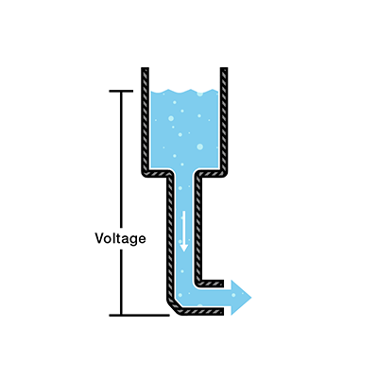
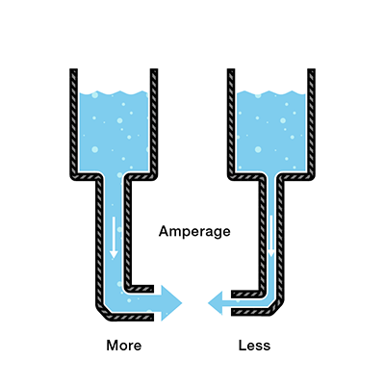
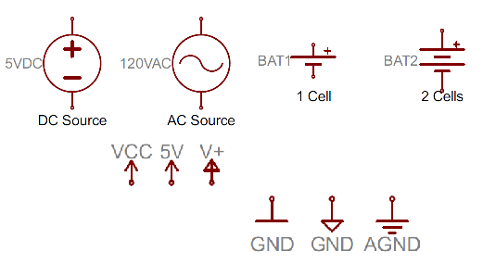
Voltage and Current
Notes:
Voltage:
A force that pushes current through the circuit.
Achieved using differences in potential (analogous to pressure differences in water pipes)
Electricity flows from higher potential (positive terminal) to lower potential (negative terminal) but electrons actually move the opposite direction
Measured in volts (V)
Current
flow of electrons through a circuit but convention wise current is opposite of electron flow
Analogous to water flow in pipe
Represents the amount of charge passing through per second
Measured in Amperes (A), AKA Amps.

Slide 19
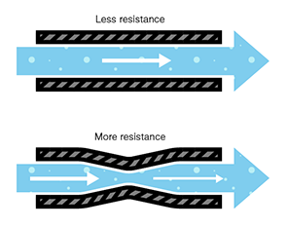
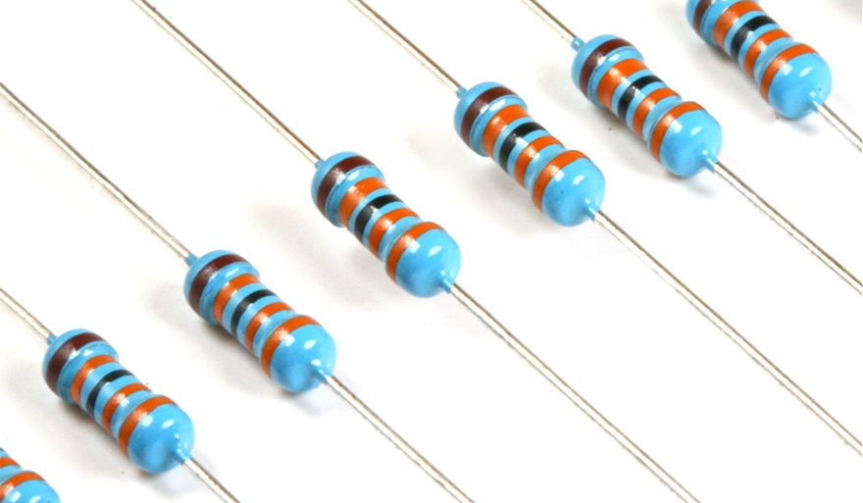
Resistance
Notes:
Resistance
Analogous to the thinning of a tube
Resistance depends on the type, cross-sectional area, and temperature of the material
Dissipates power as heat
Measured in Ohms (Ω)
Capacitors store energy in a circuit and will take time to charge and discharge
Capacitance: how much charge a capacitor stores per voltage
Depends on the capacitor’s geometry and material
Defined by capacitance with units of Farad (F)
C = Q/V (C = capacitance, Q = charge, V = voltage across two plates)
Measured in Farads (F)

Slide 20
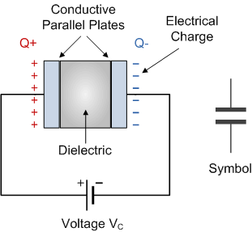
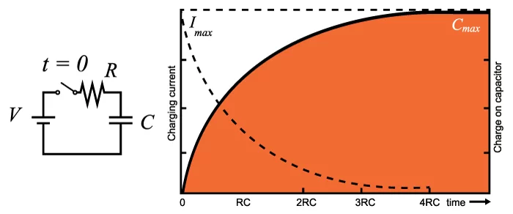
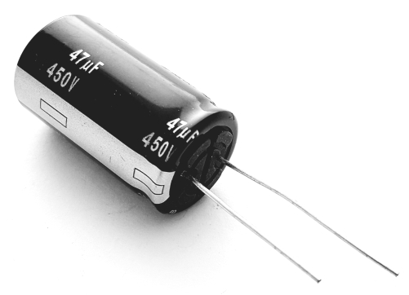
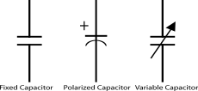
Capacitance
Notes:
Capacitors:
Elements that store energy by building up charge on one plate and preventing them from moving to the other plate where it wants to go
Imagine a tube of water with a rubber membrane in the middle. A pump is pushing water towards the left, but the membrane stops molecules from actually moving through. What would happen?
The water that’s being pushed against the membrane will start to build up energy because they want to move to the left, but can’t. As the membrane gets stretched further and further, it will reach a point where it can’t be stretched anymore, and water can no longer be pushed through the circuit
Takes time to charge and discharge → this time-dependent behavior gives capacitors special applications in circuits

Slide 21
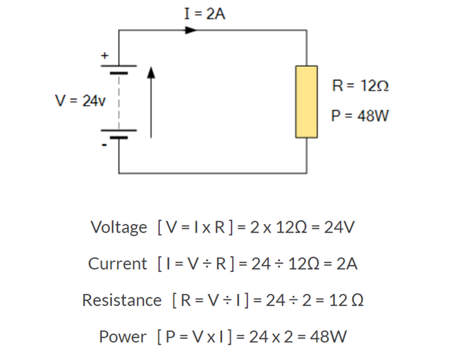
Ohm’s Law

Slide 22
Circuit Diagrams
Notes:
Symbols are used to identify components of circuits in electrical diagrams, sometime more than one symbol denotes the same thing

Slide 23
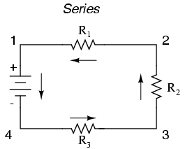
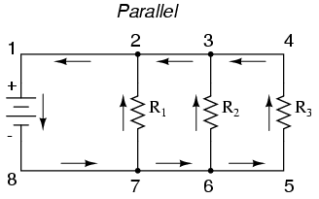
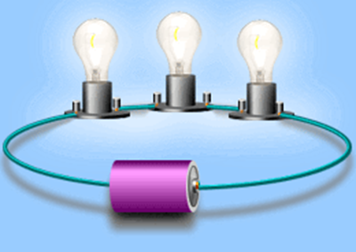
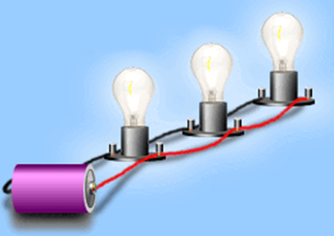
Simple Circuits
R_{eq} = R₁ + R₂ + R₃ + …
1/R_{eq} = 1/R₁ + 1/R₂ + 1/R₃ + …
Notes:
Series
Components in a row
If one bulb goes out, all three will
1 path for electricity, voltage is split across components
Current is the same through all components
Parallel
Many paths for electricity with common electrical points
If one bulb goes out, the others will not
Voltage is the same in each component, current is split between each component

Slide 24
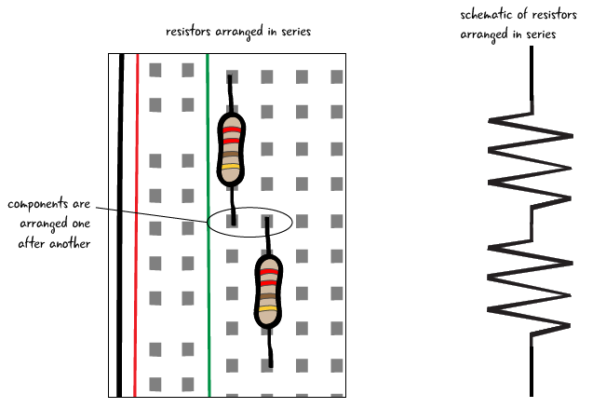
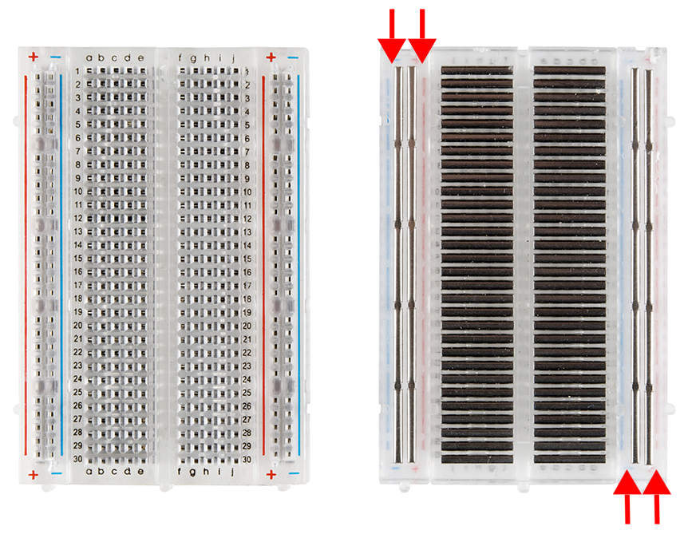
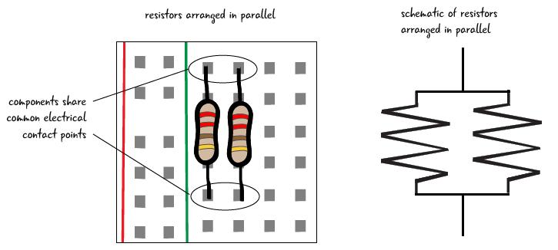
Wiring a Breadboard

Slide 25
Simple Circuit Activity

Slide 26
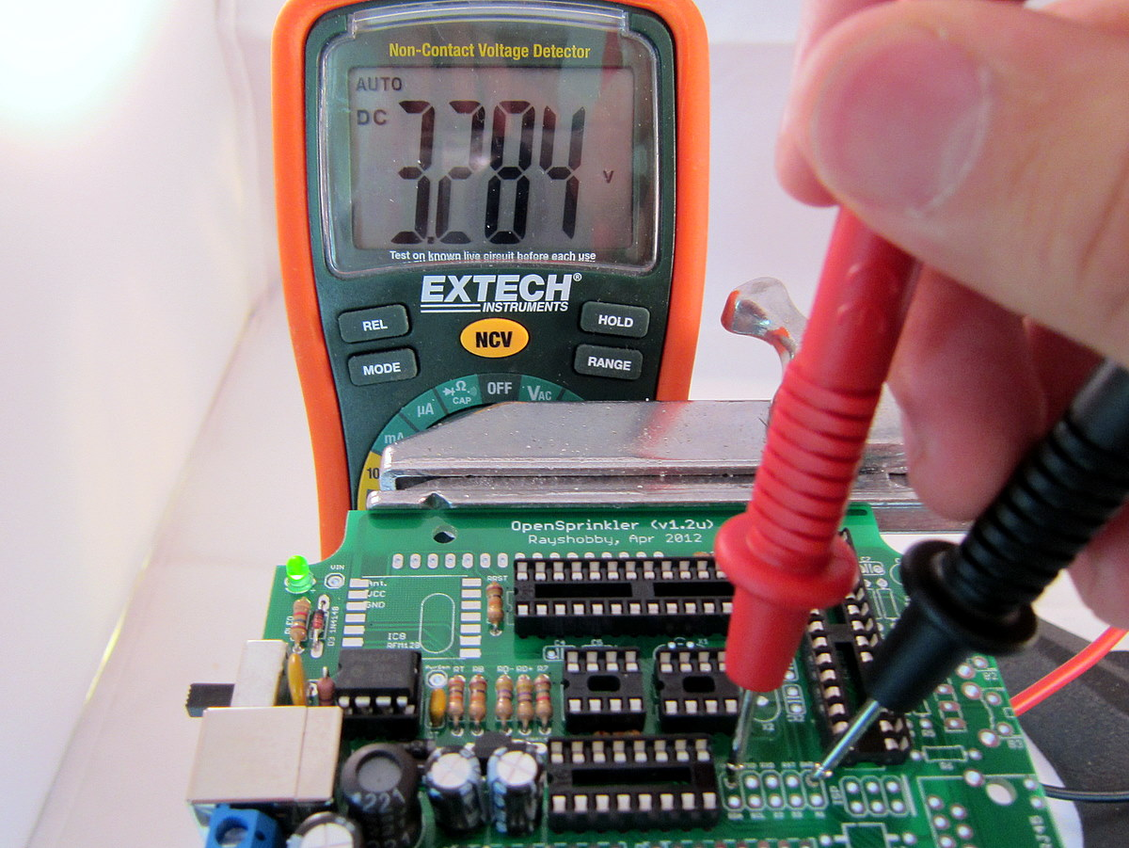
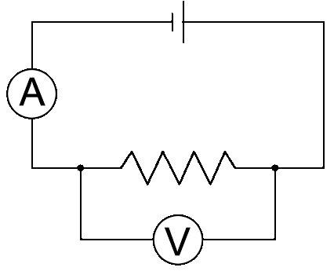
Using a Multimeter
Current
Voltage
Notes:
Measured on a voltmeter
Must be measured in parallel to the components
Measured on an ammeter
Must be measured in series with the components
Measure on an ohmmeter
Must be measured in parallel to the components (SAME AS VOLTAGE)

Slide 27
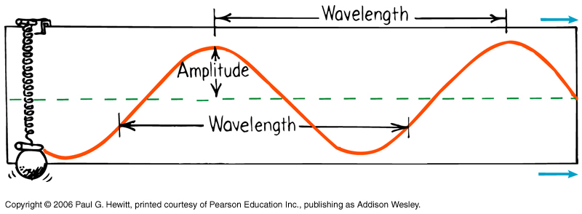
Signal Basics
Notes:
When we talk about signals, we often think about waves. What are some important features of a wave?
Amplitude -- the maximum displacement of the wave
Wavelength -- how long a full cycle takes
What about frequency? (ask students what frequency means, its relationship to wavelength)
So ideally, we get nice clean curves like the one shown here, but in reality, the signals we measure are not always clean and easy to interpret.
Draw on a board: what happens if there is noise present?
Draw “target” signal (low frequency, high amplitude)
Draw “noise” signal (high frequency, low amplitude)
Superimpose the two → result is a noisy ‘target’ signal

Slide 28
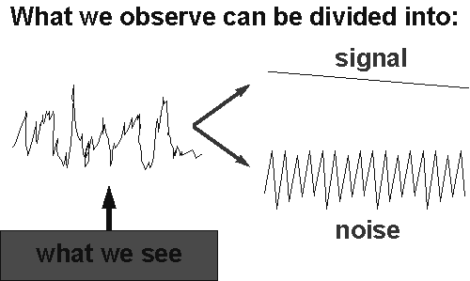
Cleaning Up Noisy Signals
Notes:
Noise = any unwanted modifications to a signal
Examples/sources of noise:
Power outlets
Static on the radio
Grainy images
Signals can be filtered to remove noise
What we observe is a sum of noise and the signal we want

Slide 29
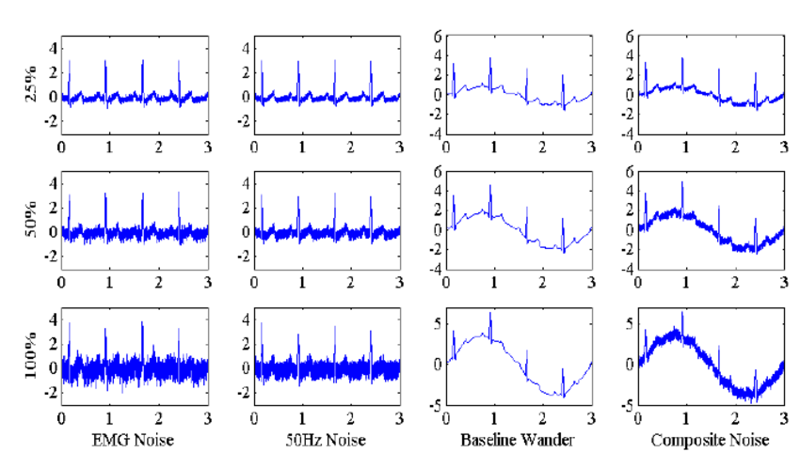
Sources of Noise
Notes:
EMG - electrical activity of other muscles - 10KHz
Power line - electromagnetic field interference by the power line or other machines and improper grounding - 50-60Hz
Baseline wander - movement and respiration - 1Hz
Within our own bodies, what else is generating action potentials besides the heart? (Muscles)
If you look around the room, there are tons of outlets → these outlets produce voltages at around 50 Hz that can also be picked up
Baseline wander → what does your body naturally do at a frequency of around 1 Hz that would also produce noise? (breathing, involves muscle contraction/relaxation)
Frequency Range of an EKG: 20-400Hz
Amplitude Range: 0-3.0mV
How can we get rid of noise that is very high frequency (> 400 Hz)?
How can we increase the amplitude of the signal so that it’s detectable?
Can we use low-pass filters to remove 60 Hz noise?

Slide 30
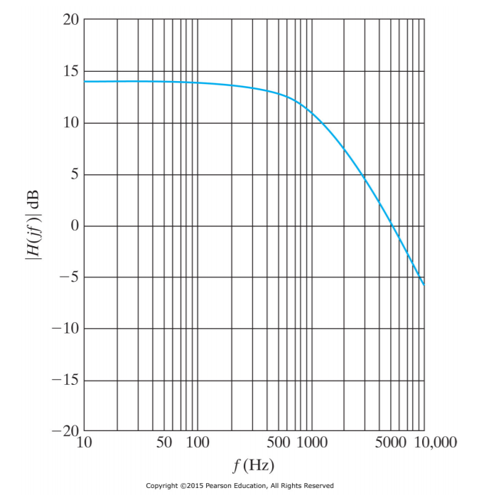
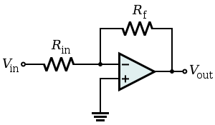
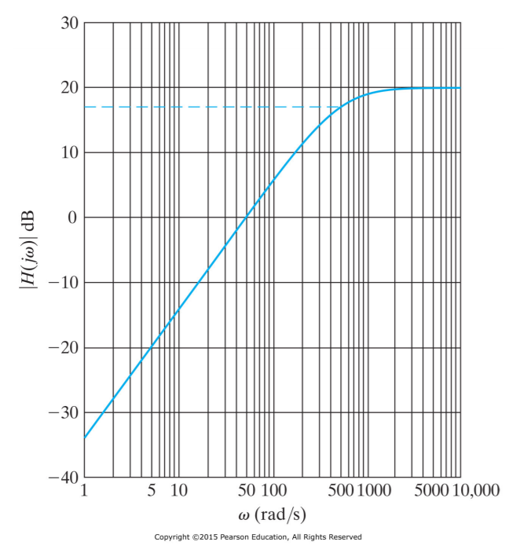
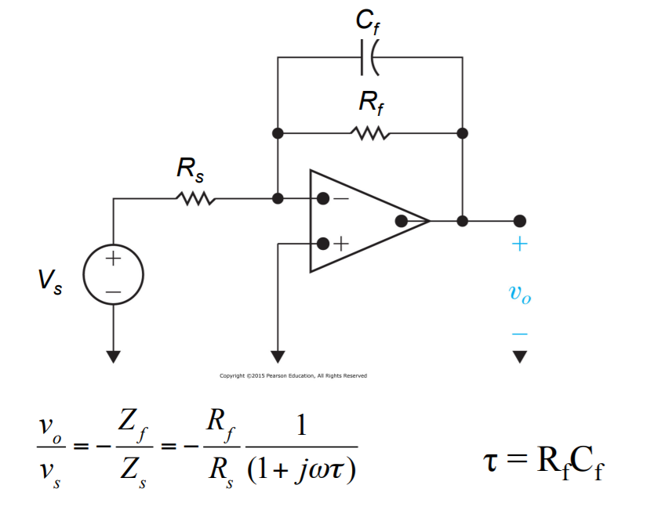
Amplification and Filtering
Amplifying circuit:
Gain = R_{f}/R_{in}
Low Pass
Low-pass filter: Gain = R_{f}/R_{s} Cutoff Freq = 1/(2πC_{f}R_{f})
High Pass
Notes:
Luckily, there are ways to build circuits that can clean up our signals. We can use amplifiers to amplify the signal we want, and we can also use them to filter out signals we don’t want.
A simple amplifying circuit will multiply your signal by a certain amount to increase or decrease the amplitude of the signal.
A filter will allow through certain frequencies of signals. For example, a low-pass filter will only allow low-frequencies to pass through the filter and be measured.
EKGs measure the change in potential in your body that results from heart contractions. However...
The amplitude of an EKG ranges from 0 to 0.3 mV, which is too low to be detected
There’s a lot of noise coming from the environment and even from our own bodies
Operational amplifier - active components that can amplify and filter input signals
Gain - Ratio of output voltage (V_{out}) to input voltage (V_{in})
Cutoff Frequency - Frequency at which half of the power is cutoff by the filter
Low-pass Filter - Filter which removes all frequencies above cutoff
High-pass Filter - Filter which removes all frequencies below cutoff
Band-pass Filter - Filter which permits frequencies within a certain range

Slide 31
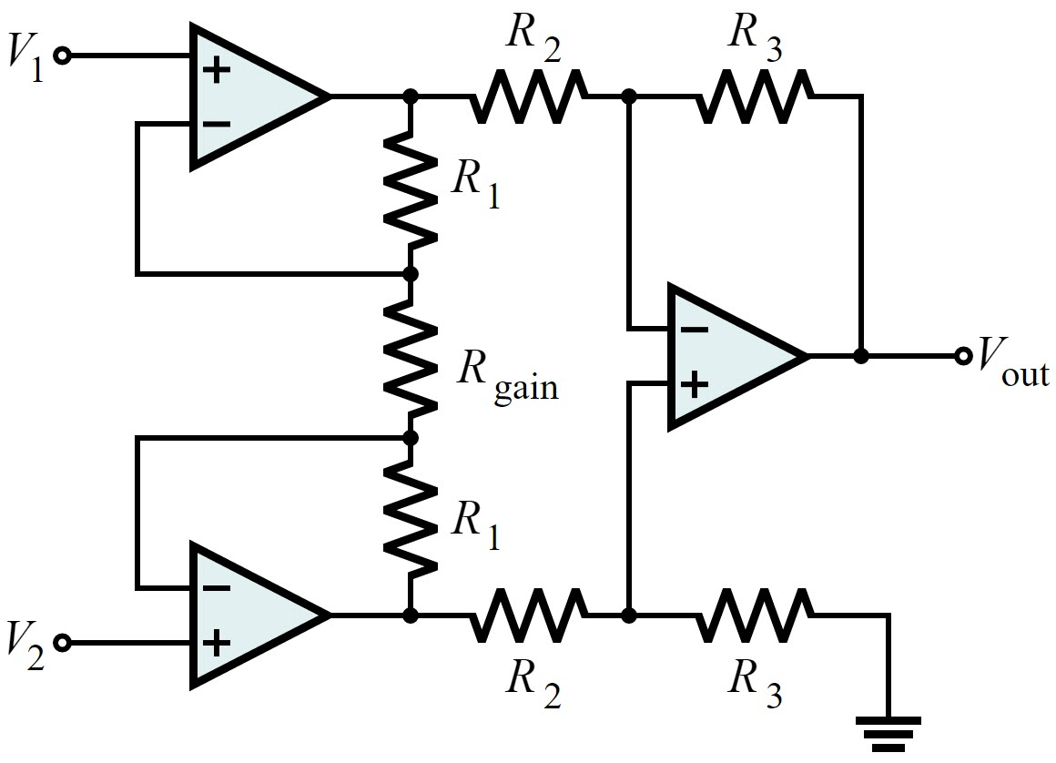
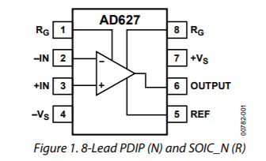
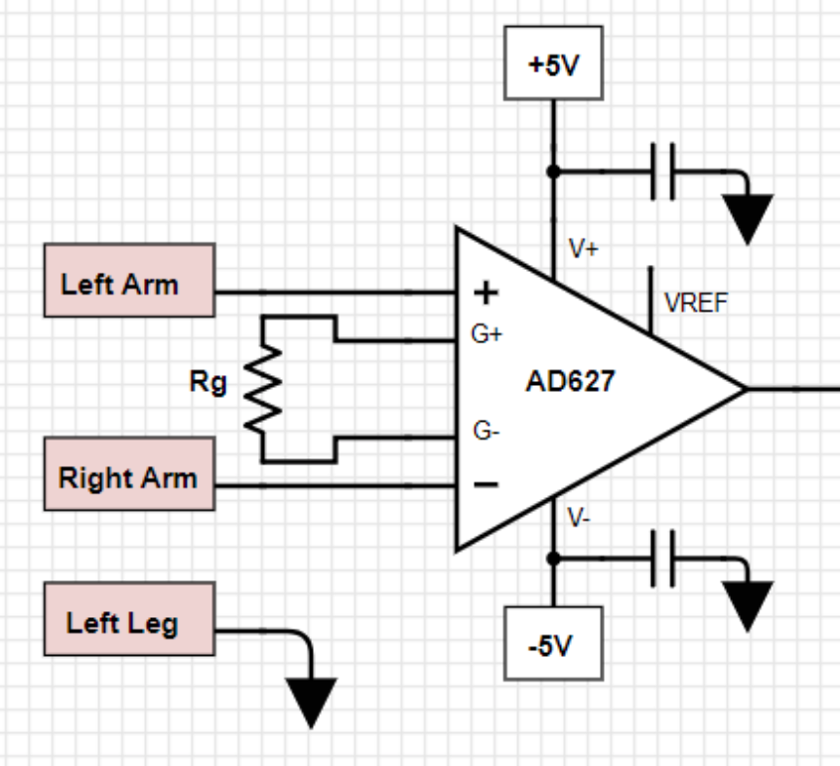
Instrumentation Amplifier
Buffer Circuit
Differential Amplifier
Notes:
Instrumentation Amplifier - Special amplifier which amplifies the difference between two input signals
Composed of 3 op-amp circuits
Performs same function, but filters out interference (noise) in signals
For EKG, there is interference at 60Hz, but this frequency overlaps with the frequency of EKG signals
Instrumentation amplifier removes the common 60Hz noise from each input

Slide 32
Basic EKG Principle
Notes:
So in order to have a clean, interpretable EKG, we need to do some signal processing.
What drives electricity to flow from one place to another? -- Potential differences
This applies to our body too → potential differences (known as action potentials) will cause heart contractions
So if you stick an electrode on your left arm, and another on your right arm, you can measure that potential difference
Now, both inputs will be noisy, and both will contain “common” noise, like the 60 Hz signal
Using an instrumentation amplifier, we can keep the difference of the left and right arm potential
What happens to the common 60 hz noise?
(Vleft + 60Hz noise) - (Vright + 60Hz noise) = Vleft-Vright ← common noise is removed from the signal
The next part of our circuit then takes that difference, further amplifies it, and also removes high frequency noise that wasn’t removed by the first filter.

Slide 33
EKG Activity
LM741

Slide 34
Importance of EKGs
Notes:
Ask each group to come up with answers to questions
What are EKGs used for?
Cardiovascular disease is a leading cause of death worldwide
Medical
Monitor vitals during hospital stays
Diagnosis of structural or rhythmic abnormalities
Observe effects of cardiac medication or anesthetics
Monitor heart health after heart attack, stroke, or other cardiac events
Assess cardiac stress and overall heart health
Commercial
Monitor heart rate during exercise
Alert upcoming cardiac event
Manage heart conditions
Observe overall heart health

Slide 35
Unequal Access to Basic Medical Equipment
EKGs are one of the most basic tools but costs range from $2000-$15000
What if an EKG breaks in a developing country?
Doctors may not be trained to use or fix it
Unreliable electricity means unreliable results
Not suitable for conditions
Lack of access for replacement parts
Notes:
Africa has 24% of the global disease burden and only 1-2% of medical professionals

Slide 36
Medical Equipment Sourcing
80% is donated to developing countries or purchased used
More than 40% of donated technology is not used
No reliable electricity
Not suitable for high heat or humidity
No doctors trained in use
No replacement parts or consumables
Notes:
Only 8% of medical devices are intended to be used by non-medical professionals

Slide 37
How can bioengineers help?
Shifting design principles to think about low resource settings
What are 5 design considerations you would make for a medical device?
How would these considerations be prioritized?
What might you prioritize in a medical device for a resource-poor area?
Notes:
Have each group come up with 5 design considerations, then write on a board. Fill in anything that might be missing
Consumer Cost
Profitability
Electrical requirements
Ease of operation/ use
Required consumables
Available replacement parts
Product longevity

Slide 38
In Conclusion…
“Biomedical engineering is considered as the profession responsible for innovation, research and development, design, selection, management and safe use of all types of medical devices, including single-use and reusable medical equipment, prosthetics, implantable devices and bionics, among others.
A key objective of biomedical engineers is to have devices that are of good quality, effective for the intended purpose, available, accessible and affordable. When these objectives are met and devices are used safely, patients’ lives may be saved, quality of life increased and there will be positive economic outcomes; the final goal is attainment of better levels of care.” (World Health Organization, 2017)

